Slide 1
Weekly Report

Slide 2
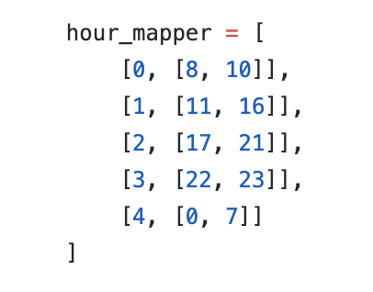
Since we decided to add time as a feature
Based on what we’ve done
We tested different time zone as follows:
Result: We tried different hour mapper assigned by different time zone, but the result was not clear.

Slide 3
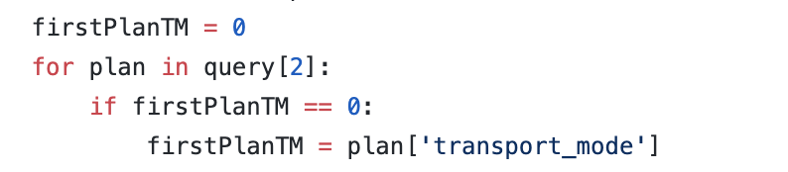
New Added Features
1.Set dISTANCE AS dISTANCE/ETA
2. Set Price as Price/eta
3. The First Plan mode of each session

Slide 4
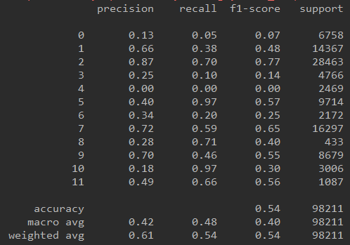
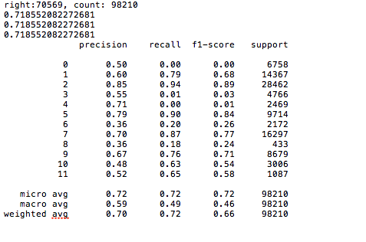
Use k-mean to divide the users to 3 different Groups
K-mean
Cloud Side Testing:
Local Side Testing:

